Slide 1

Case Study -1
“Analysis of patients complaints in Apollo Hospital”
Guided by : Mr.Bose
Student : Venkatesh D.S
Academic:2019-2020

Slide 2

Introduction..
The City Apollo Hospital Conducted a survey to analyse the various patients complaints and resolve this complaints to maximum extent and to provide patients gratification.

Slide 3
List of categories included in Complaint form…
Information provided
Time Table
Received treatment
Forms missing
Solving time
Too many formalities
Personnel skill
Waiting time
other

Slide 4

Complaints Received…
Category
Number of Complaints
Information provided
Time Table
Received treatment
Forms missing
Solving time
Too many formalities
Personnel skill
Waiting time
other
210
60
92
13
320
75
18
53
4

Slide 5

Complaints are Analysed by using “Pareto chart”..

Slide 6
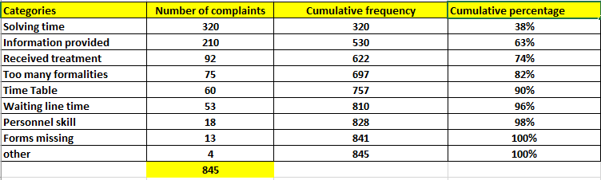
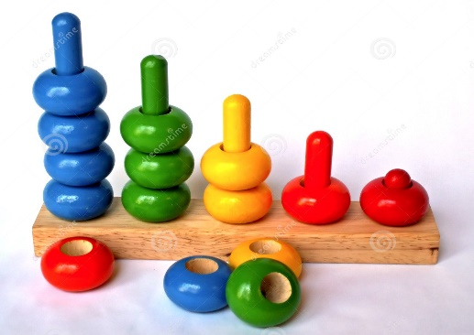

Step-1: Sort the complaints in Decending order. Calculate the cumulative frequency and cumulative percentage….

Slide 7
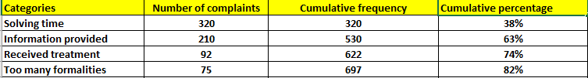
From the below table we can conclude that …. Solving time, Information provided, Received treatment, Too many formalities contributes 82% of data….

Slide 8

It’s time to draw “Pareto chart”……..

Slide 9
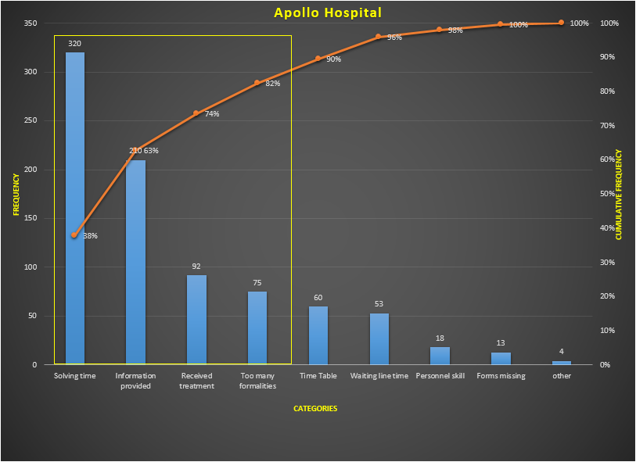
Pareto chart…
From the chart we can conclude that…
By solving complaints like Solving time, Information provided, Received treatment, Too many formalities .
80% of complaints can be solved and customer satisfaction can be reached to maximum extent.

Slide 10

Thank you….

